Slide 1
1st floor
Conference room
Office
Stairs
Elevator
Washroom (female)
Office
Washroom (male)
Office
Office
Office
Conference room
Office
Break room
Office
Office
Office
Locker room (female)
Locker room (male)
Conference room
Stairs

Slide 2
2nd floor
Stairs
Elevator
HVAC
Stairs

Slide 3


Ground floor
Entrence
Description:
Stairs
Media
storage
Elevator
D Class
Corridor
Media reserve room
Media
prep/ storage
C Class
Administration
Personnel Airlock (female)
Material Airlock
CNC
Administration
Personnel Airlock (male)
Personnel Airlock (male)
NC
Warehouse
Inoculum
Personal
Corridor
Product
Personnel Airlock
Waste
Material
USP Production
Buffer prep & storage
DSP V+
Personnel Airlock
Emergency Exit
USP harvest
Material Airlock
PA
PA
Corridor
Personnel Airlock
MA
Cleaning
DSP Storage
Quality Control
Restaurant/Cafeteria
PA
DSP freezing
DSP freezing
DSP V-
MA
PA
PA
MA
Stairs

Slide 4










Point of use
Description:
Corridor
Media prep
Media
storage
Administration
Personnel Airlock (male)
Personnel Airlock (female)
Material Airlock
D Class
Personnel Airlock (male)
C Class
Inoculum
CNC
Corridor
NC
Personnel Airlock
USP Production
Personal
Buffer prep & storage
DSP V+
Personnel Airlock
Product
Waste
Material
Process Gases (N₂, O₂, CO₂)
USP harvest
Liquid Waste
Material Airlock
Solid Waste
Biological Liquid Waste
PA
PA
Clean Steam
Corridor
Personnel Airlock
Process Air
MA
Cleaning
DSP Storage
Quality Control
WFI
PA
DSP freezing
Cooling Water
DSP V-
PW
MA
PA
Clean Compressed Air
PA
MA

Slide 5
Entrance
Stairs
Elevator
Basement
Corridor
Media prep
Media
storage
Administration
Personnel Airlock (male)
Personnel Airlock (female)
Material Airlock
D Class
Personnel Airlock (male)
C Class
Warehouse
Inoculum
CNC
Corridor
NC
Personnel Airlock
USP Production
Personal
Buffer prep & storage
DSP V+
Material Airlock
Product
Waste
Material
Process Gases (N₂, O₂, CO₂)
USP harvest
Liquid Waste
Personnel Airlock
Solid Waste
Biological Liquid Waste
PA
PA
Clean Steam
Corridor
Personnel Airlock
Process Air
PA
DSP Storage
Quality Control
WFI
PA
DSP freezing
Cooling Water
PA
PA
DSP V-
PW
PA
Personnel Airlock
Clean Compressed Air
Stairs

Slide 6

Corridor
Media prep
Media
storage
Administration
Material Airlock
Personnel Airlock
D Class
Inoculum
C Class
Corridor
CNC
Personnel Airlock
NC
USP Production
Buffer prep & storage
DSP V+
Material Airlock
Personal
Product
Waste
Material
USP harvest
Process Gases (N₂, O₂, CO₂)
Personnel Airlock
Liquid Waste
Solid Waste
PA
PA
Biological Liquid Waste
Corridor
Personnel Airlock
Clean Steam
PA
DSP Storage
Quality Control
Process Air
PA
DSP freezing
WFI
Personnel Airlock
PA
PA
Cooling Water
DSP V-
PA
PW
Personnel Airlock
Clean Compressed Air

Slide 7
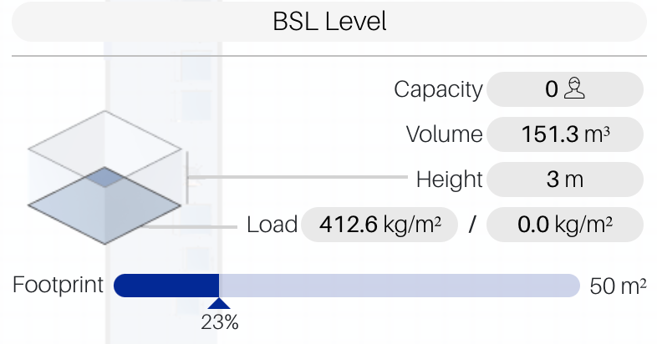
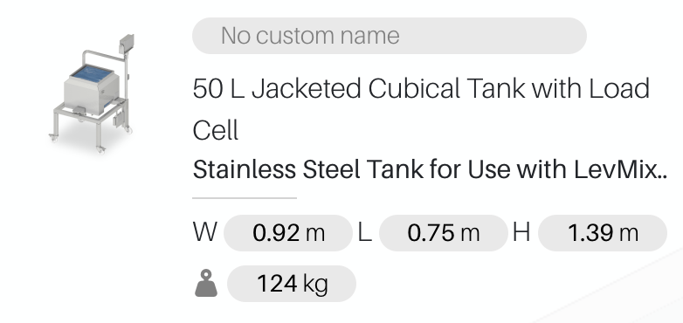
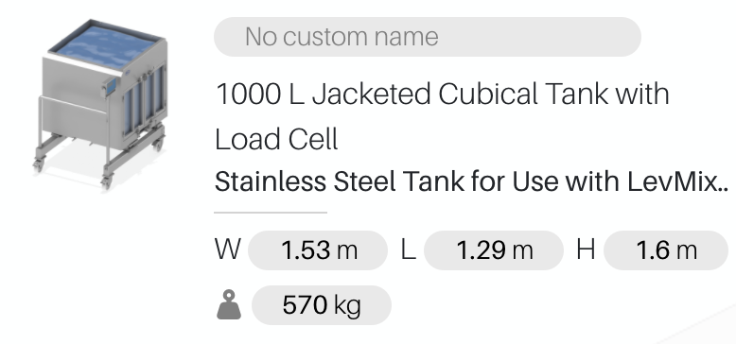
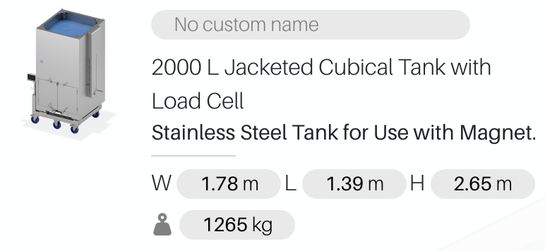
Media Preparation and Storage Room

Slide 8
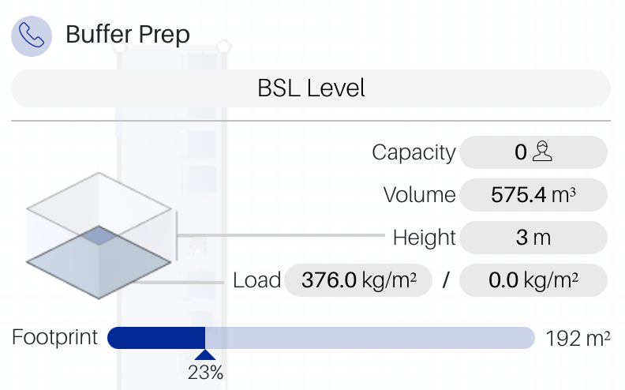
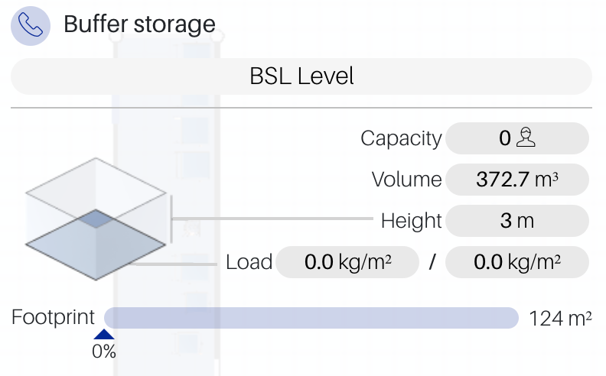
Buffer Preparation and Storage Room

